Slide 1

Kafka Deep DIVE Updated 26 January 2021
From zero to hero
… somewhat. At least enough to get started

Slide 2
KDD > Agenda
Big Picture
Schemas
Q&A
Kafka
Katas

Slide 3
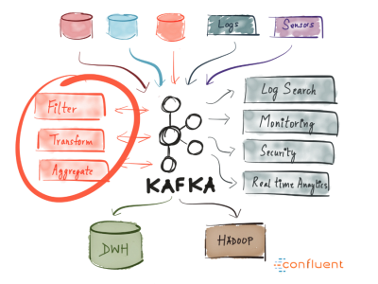
KDD > Big Picture

Slide 4
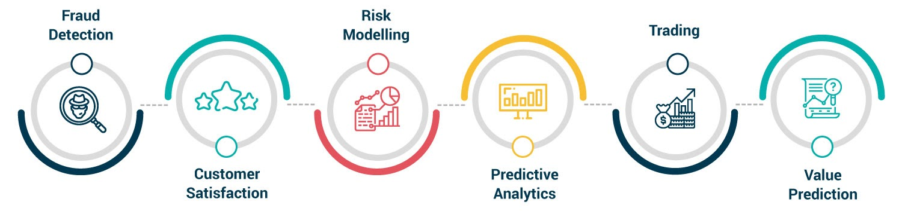
KDD > Big Picture > Use cases

Slide 5
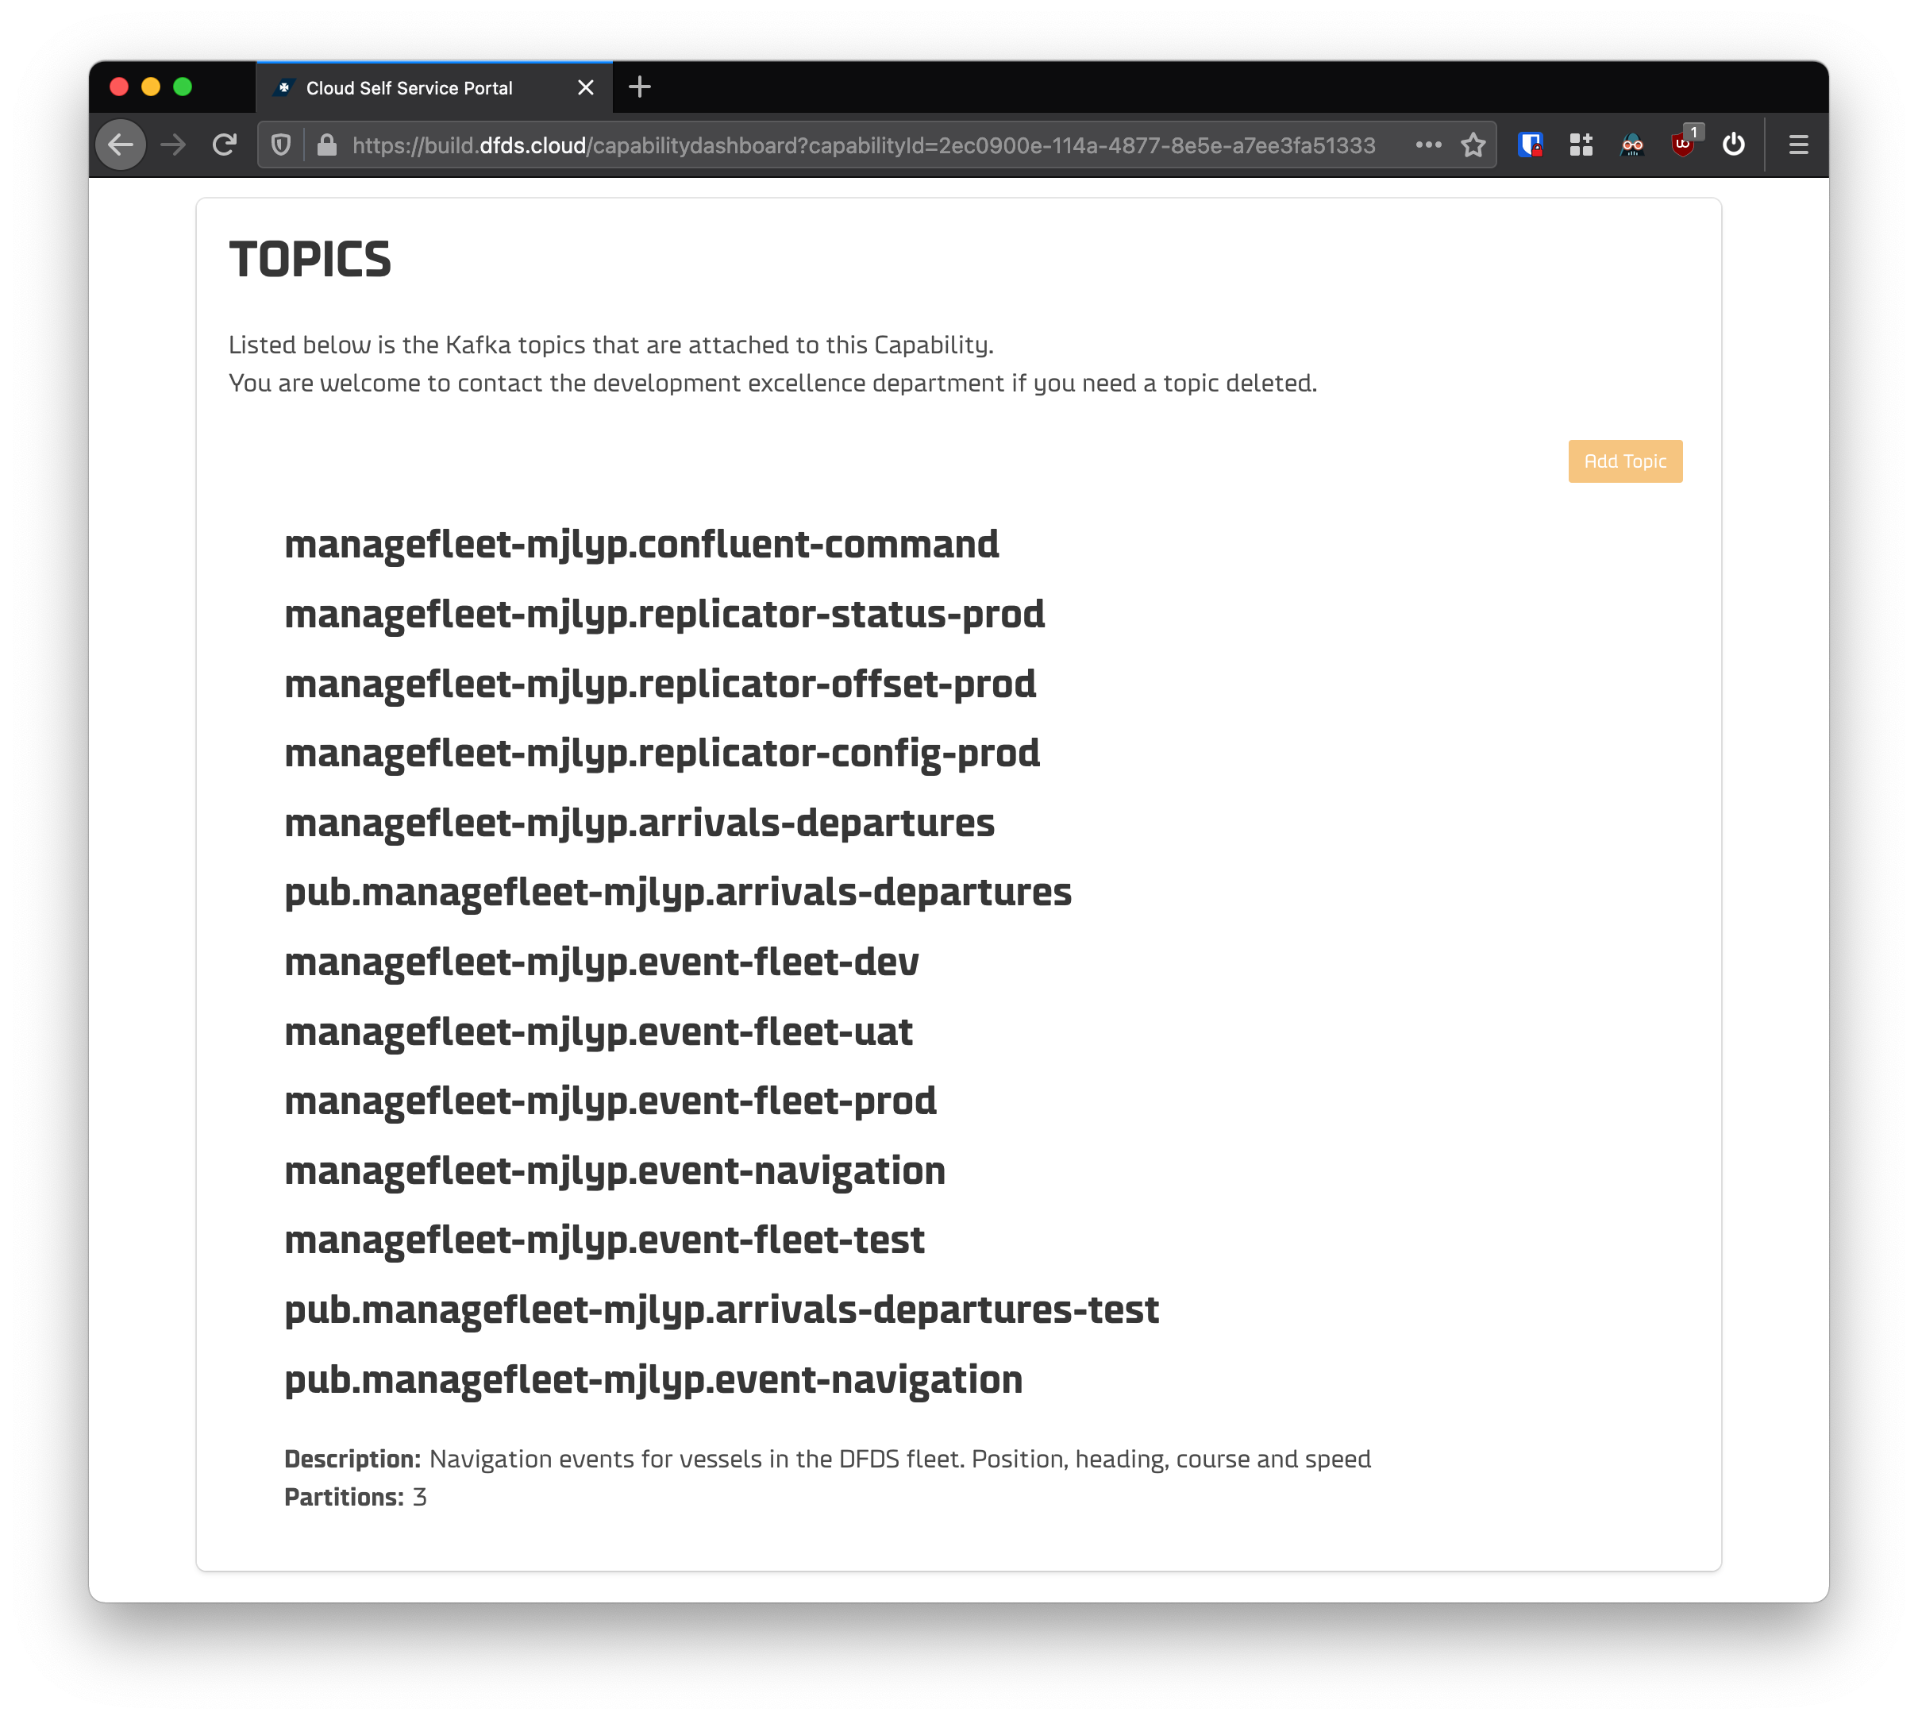
KDD > Big Picture > Use cases > @DFDS

Slide 6
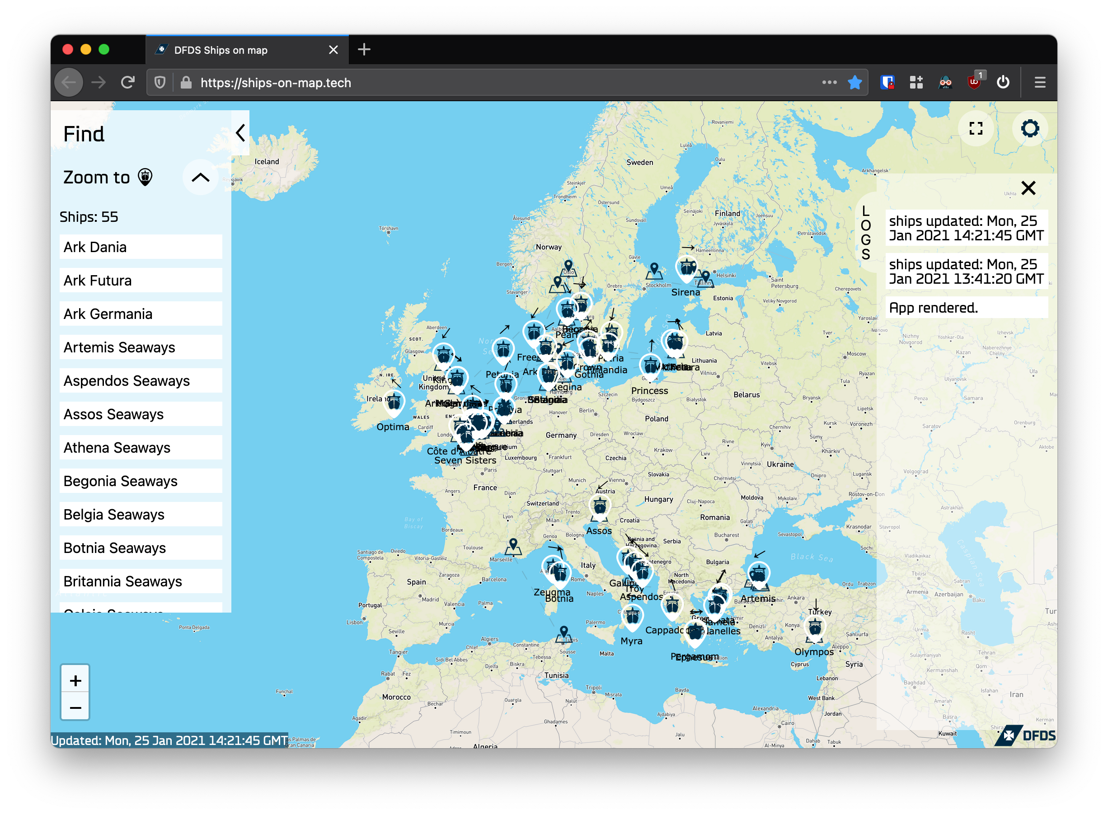
KDD > Big Picture > Use cases > @DFDS

Slide 7
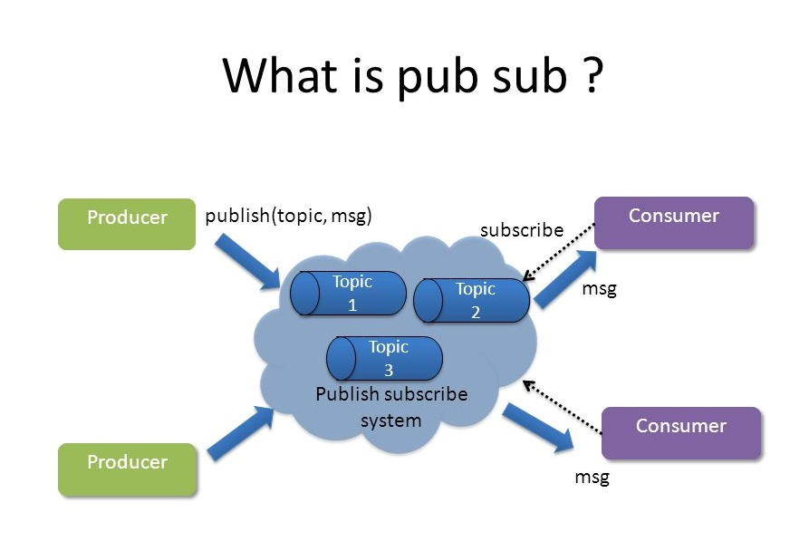
KDD > Big Picture > Pub/Sub

Slide 8

KDD > Big Picture > Demo
Notes:
Step 1 => https://github.com/pulls

Slide 9


KDD > Big Picture

Slide 10
KDD > Kafka
Consumer #1
Producer
Topic
Consumer #2
Producer #2
Topic

Slide 11
KDD > Kafka

Slide 12
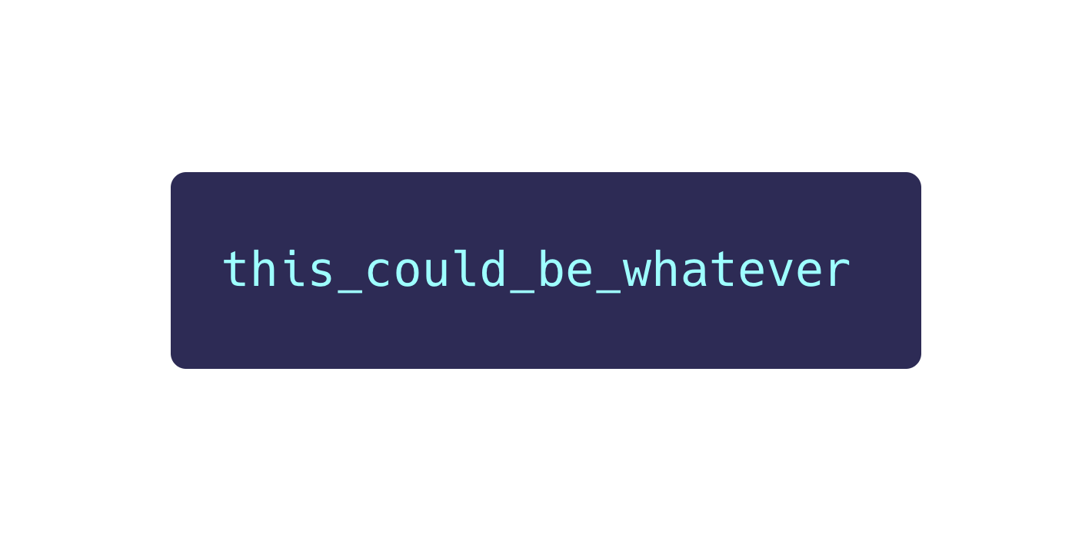
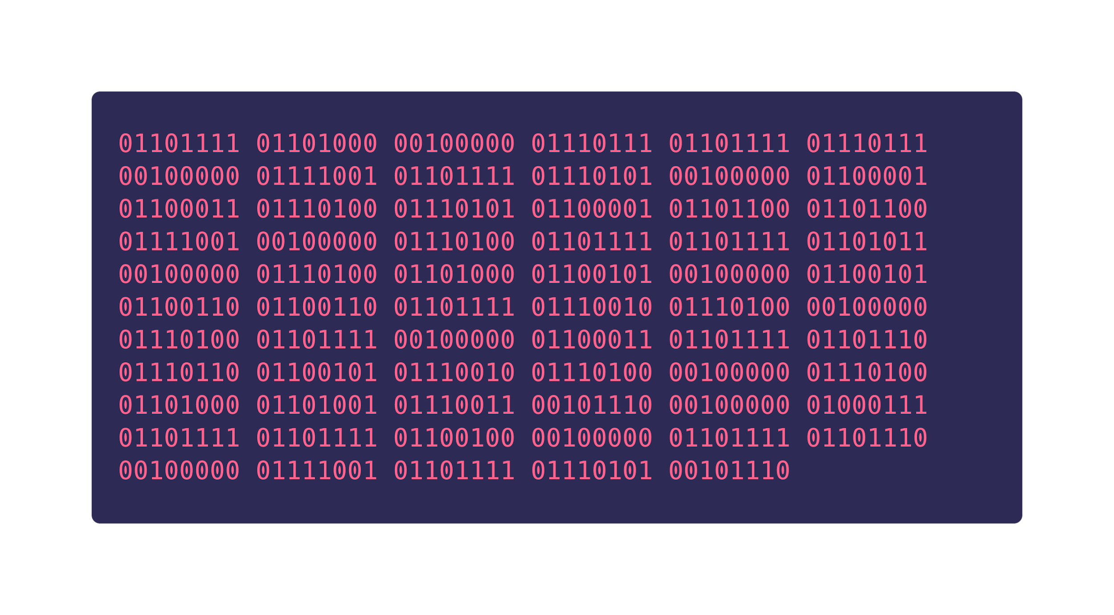
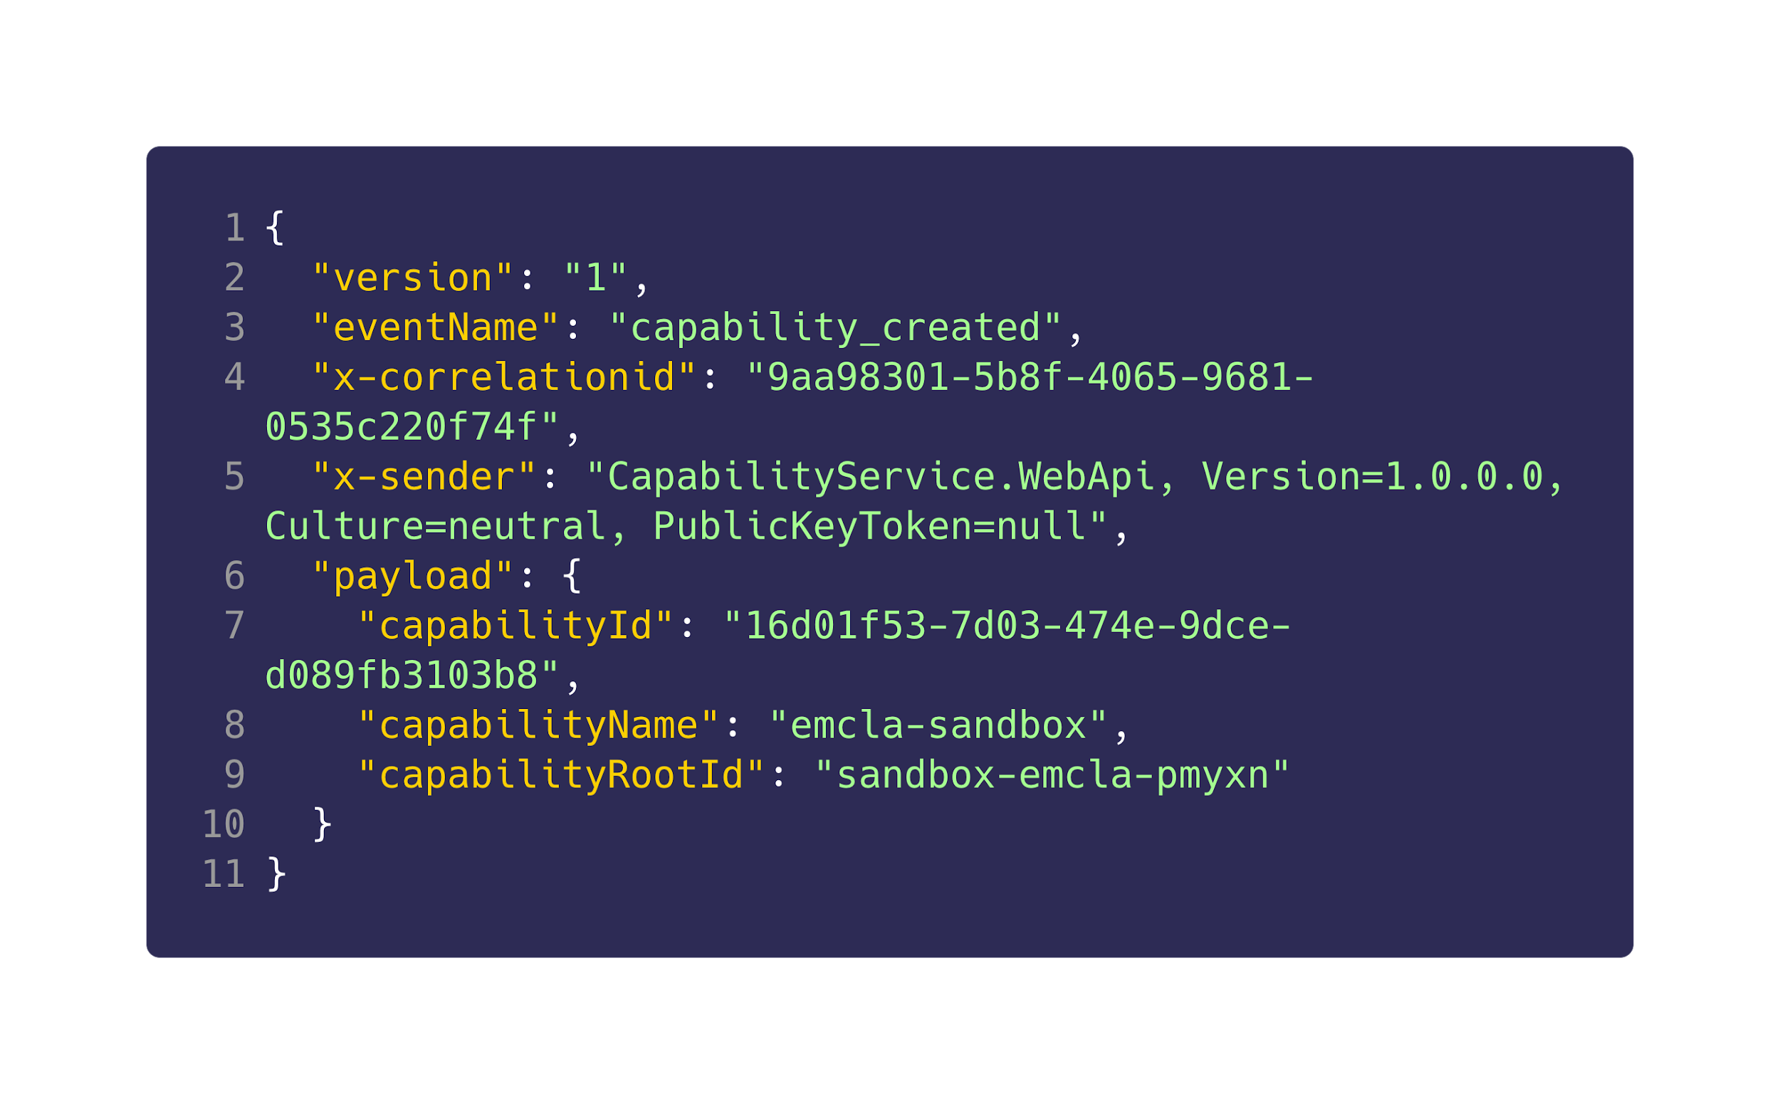
KDD > Schemas

Slide 13
KDD > Schemas > Custom

Slide 14
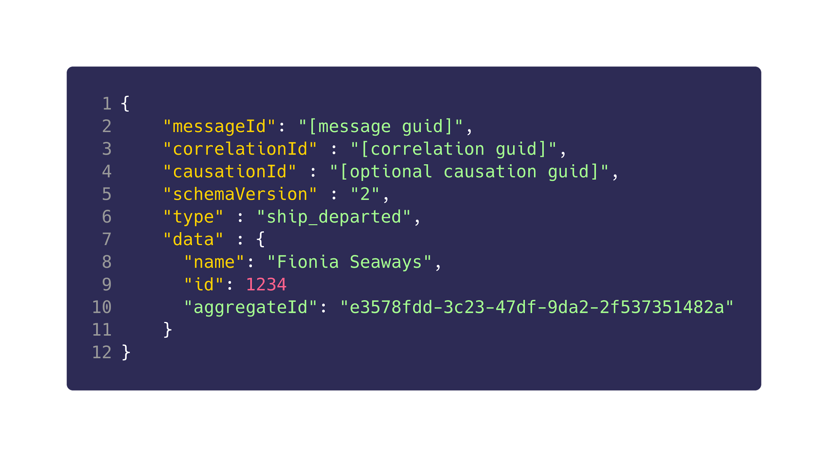
KDD > Schemas > Public

Slide 15
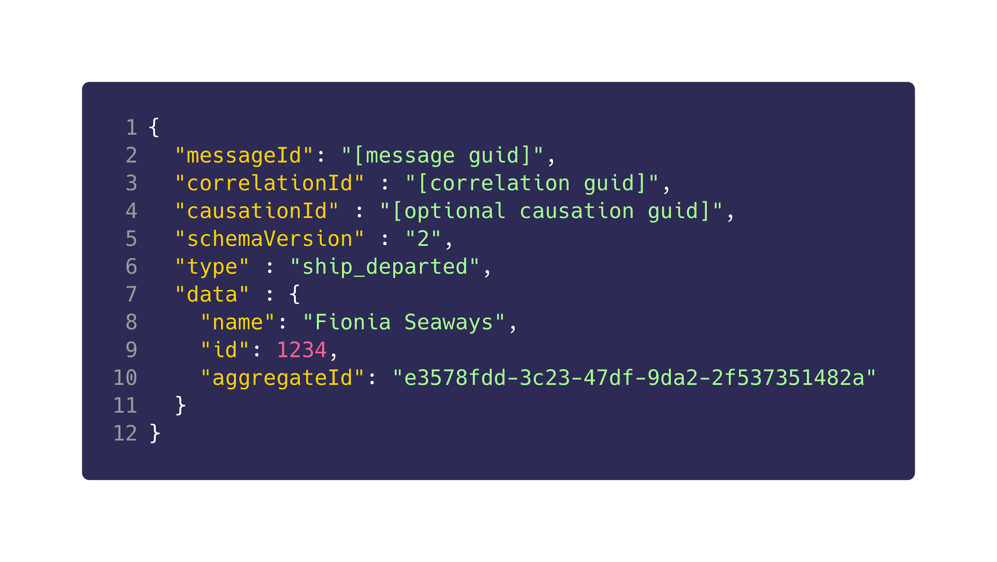
KDD > Schemas > Mapping
custom
public

Slide 16
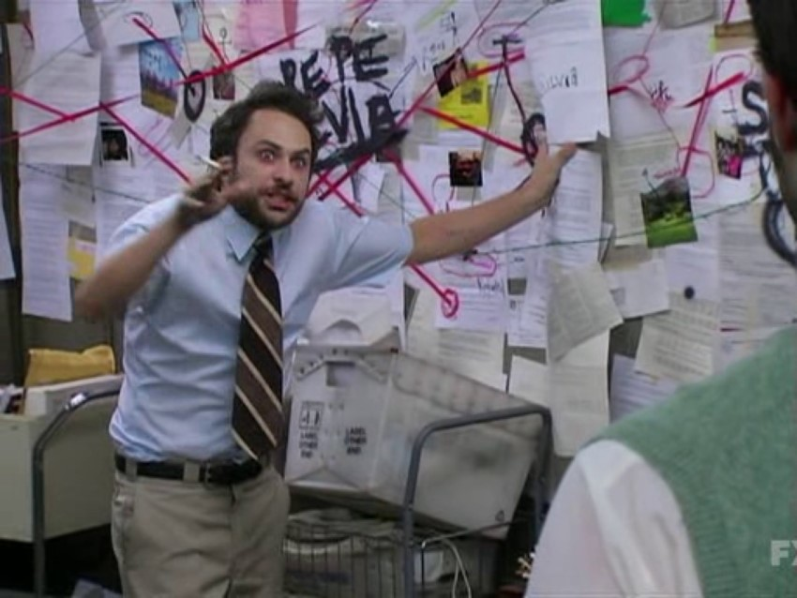
KDD > Schemas > Mapping
custom
public

Slide 17
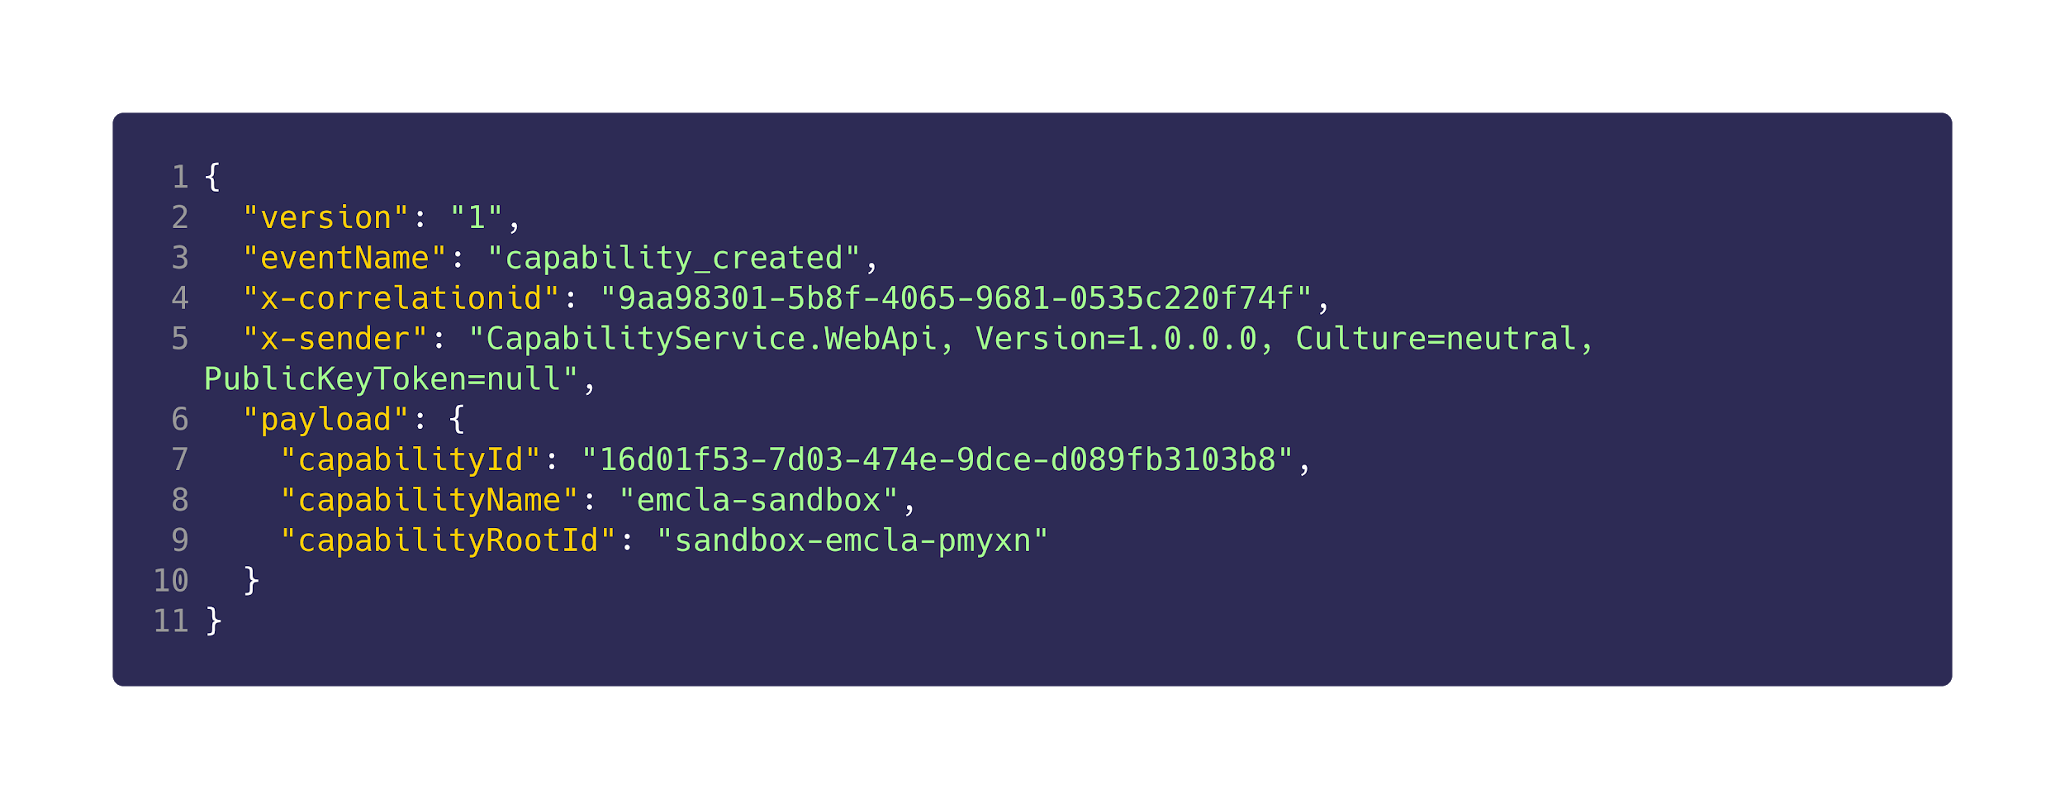
KDD > Schemas > Versioning
In case of schema format update

Slide 18
KDD > Schemas > Naming
Used to identify and handling events Naming examples:
member_joined_capability
topic_added
capability_updated

Slide 19
KDD > Schemas > Correlation
Helps keep track of an event throughout its entire lifecycle across multiple capabilities

Slide 20
KDD > Schemas > Origin
See where event originated

Slide 21
KDD > Schemas > Payload
Your event specific
data / metadata

Slide 22
KDD > Schemas

Slide 23

KDD > Katas > Code Kate #1

Slide 24
KDD > Katas > Code Kate #2

Slide 25
KDD > Katas > Code Kate #3

Slide 26
KDD > Katas > Code Kate #4

Slide 27
Kafka > Q/A

Slide 28
KDD > Feedback
https://forms.office.com/Pages/ResponsePage.aspx?id=ZpSpcwWtIUKfkOcUKqL2wTFclz-gNvpNq3THAj1j3ZxUODk1TjlEWVNJNzUxNjAwTFhGQkQ2VkNTWi4u

Slide 29
KDD > Literature
https://kafka.apache.org
https://docs.confluent.io/
https://docs.confluent.io/clients-confluent-kafka-dotnet/current/index.html
https://codeopinion.com/getting-started-apache-kafka-with-net-core/
https://medium.com/@srigumm/building-realtime-streaming-applications-using-net-core-and-kafka-ad45ed081b31

